Slide 1

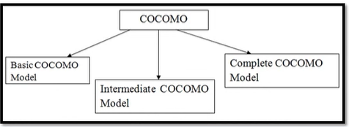
https://www.youtube.com/watch?v=PfD4G4ZZAMA

Slide 2
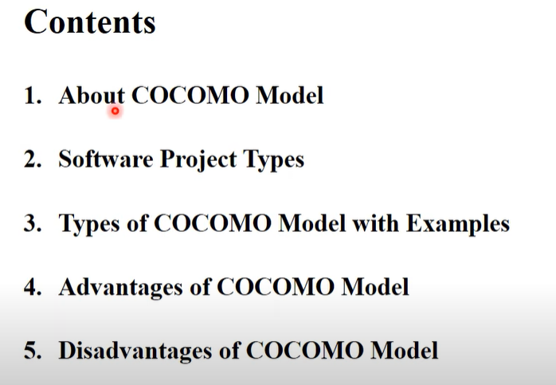
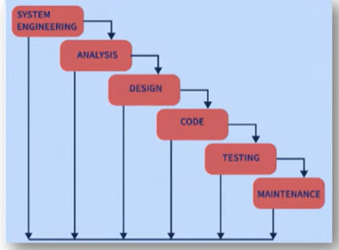

Slide 3
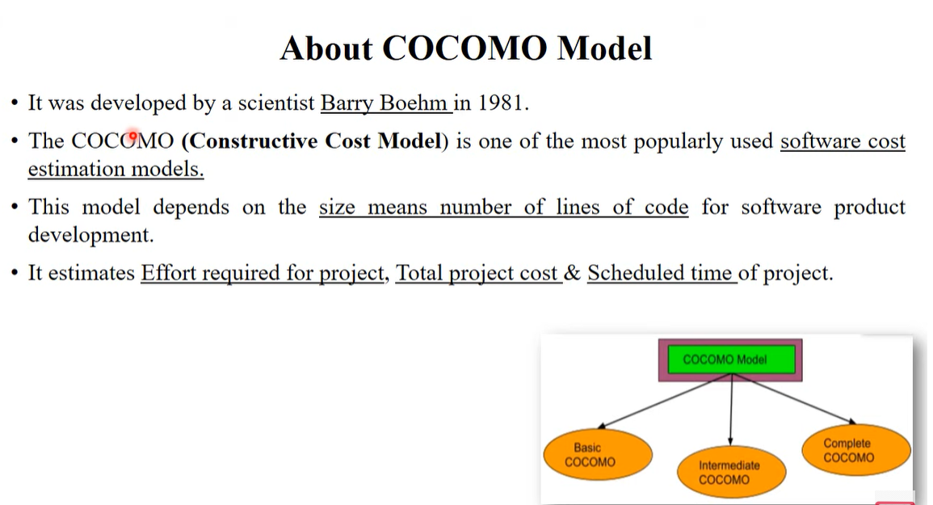
Mode | Description | Example
Organic | Small, simple projects | Payroll system
Semi-Detached | Medium complexity | Compilers
Embedded | Complex, tight constraints | Real-time systems

Slide 4
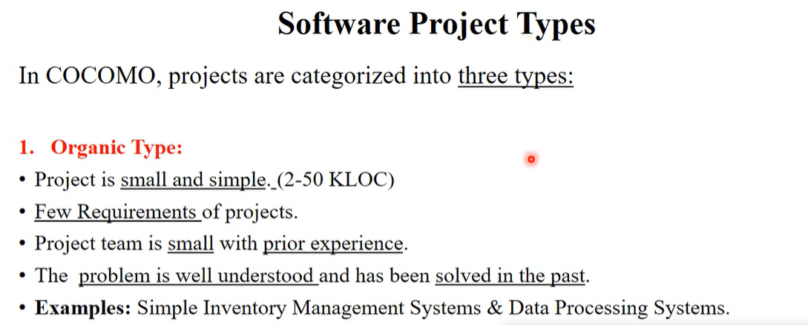
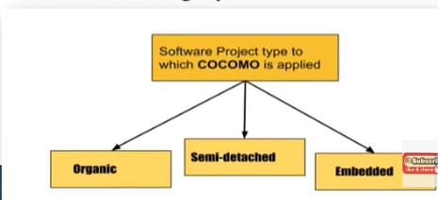
Mode | Description | Example
Organic | Small, simple projects | Payroll system
Semi-Detached | Medium complexity | Compilers
Embedded | Complex, tight constraints | Real-time systems

Slide 5
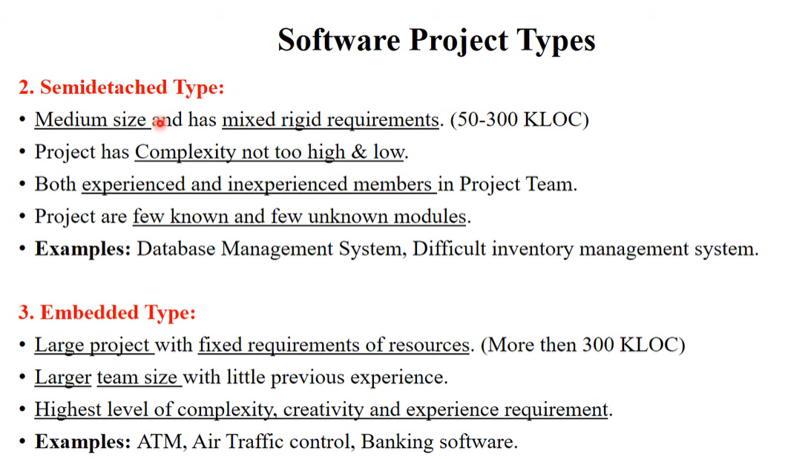

Slide 6
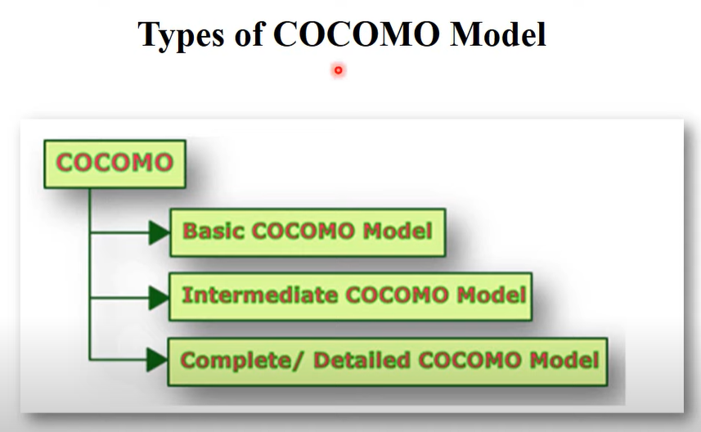

Slide 7
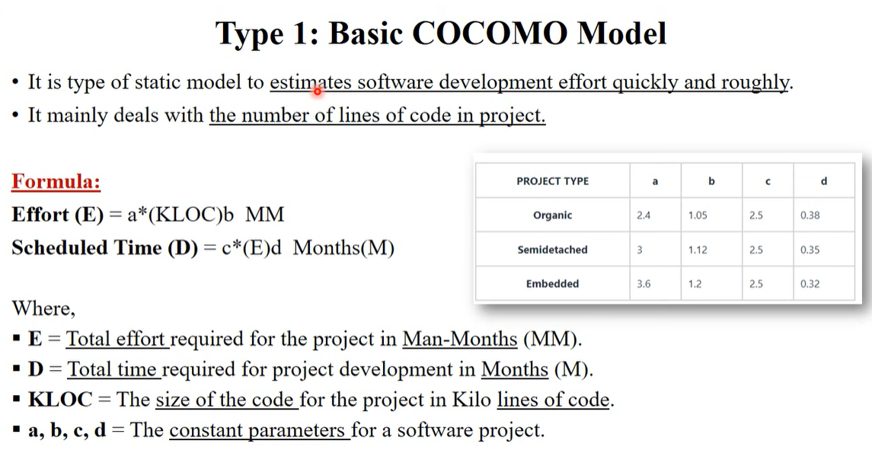



Slide 8
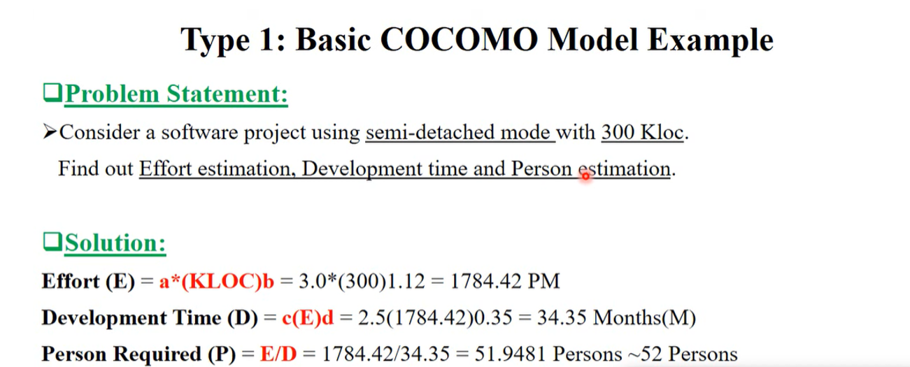
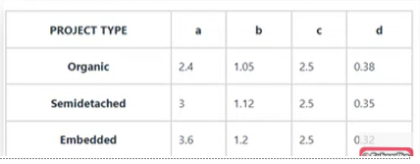

Slide 9
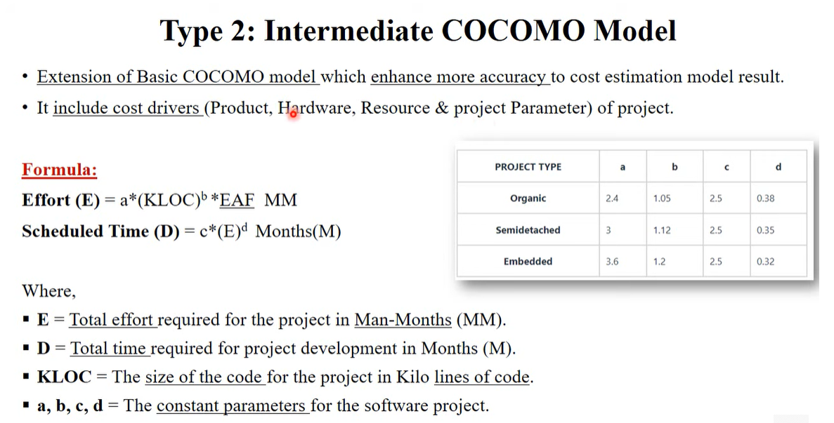

Slide 10
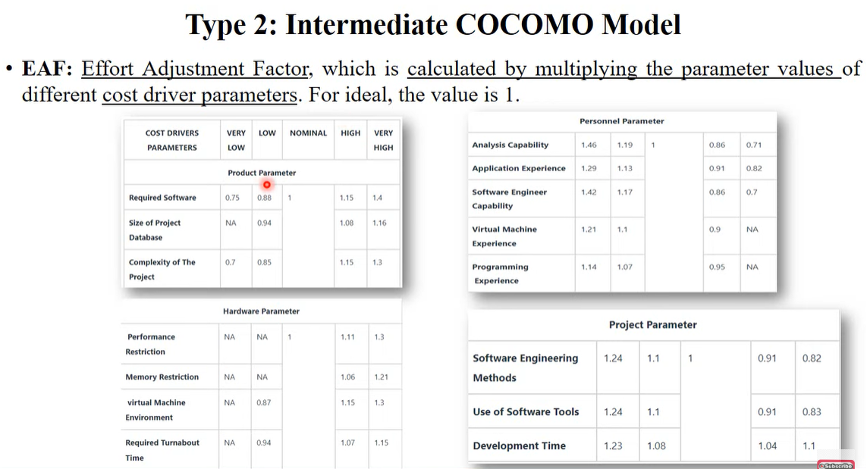

Slide 11
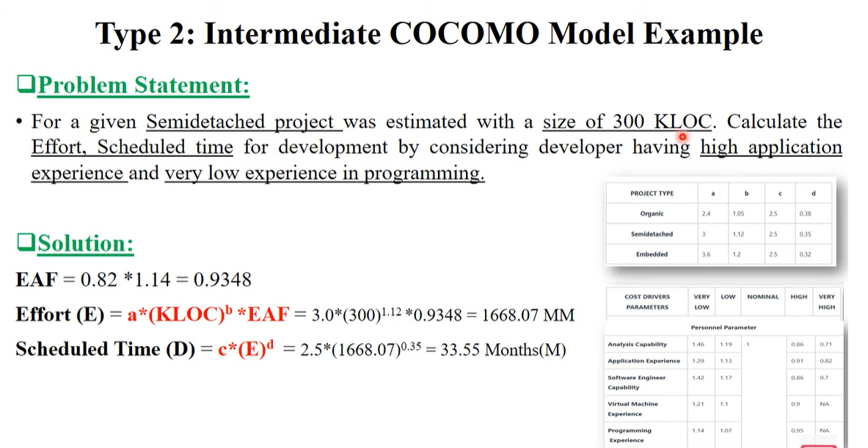

Slide 12
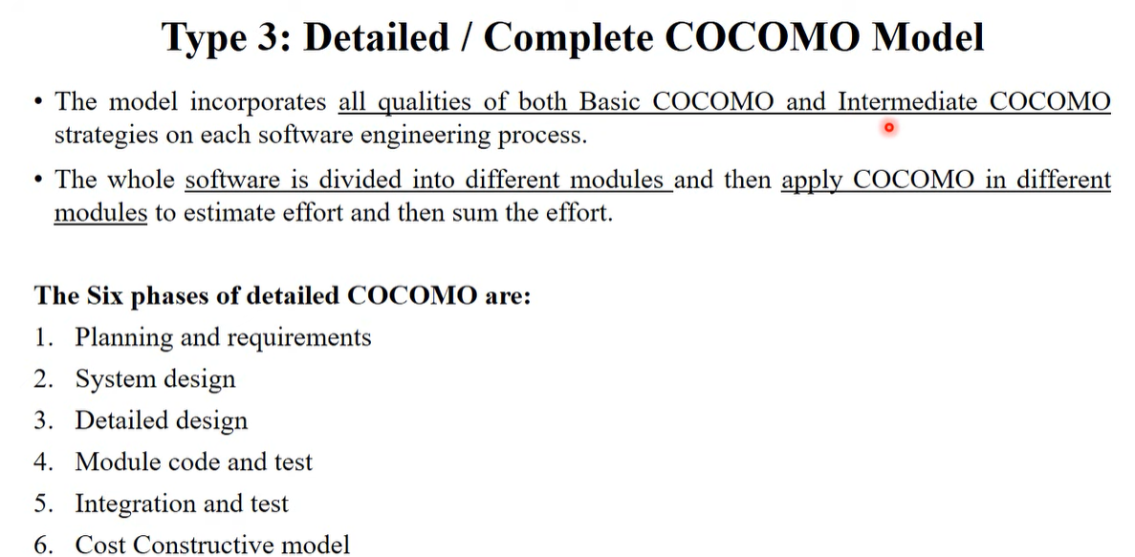

Slide 13
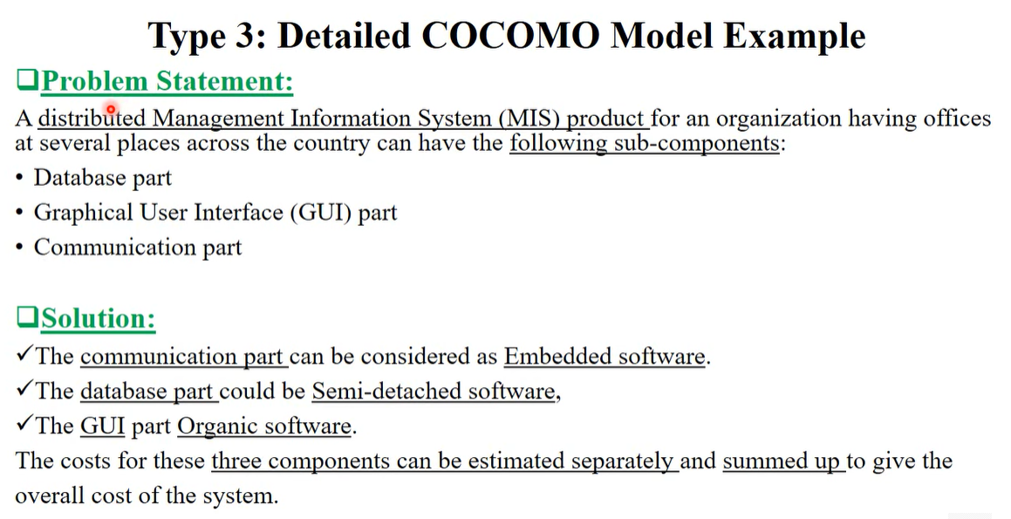

Slide 14
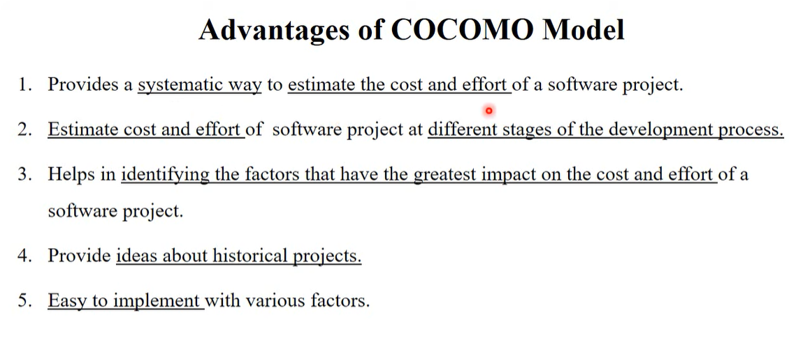

Slide 15
